Slide 1

WELCOME to OUR
PROJECT

Slide 2

HOME MADE VACUUM CLEANER

Slide 3
Group-10
EECE-21(B)
Section :B
Course :Electrical Electronics and Communication circuit lab
(EECE 102)

Slide 4
Team Members
ARKA JYOTI BISWAS
ROLL: 202316082
MD.JIMAN
ROLL: 202316101
OSAMA AHMED IBRAHIM
ROLL: 202316126
SAMIOUL AHSAN SAZID
ROLL: 202316124

Slide 5
POJECT OVERVIEW
OBJECTIVE
COMPONENTS
WORKING METHOD
ADVANTAGE & DISADVANTAGE

Slide 6
Objective:
For Easy and Quick Cleaning
To keep the environment clean
It is simple to operate and maintain
To Save Our Time

Slide 7
BODY MATERIAL
(PVC)
ARDUINO UNO
BUZZER
MOTOR DROVER
DC MOTOR
COMPONENTS
LITHIUM ION
BATTERY
ULTRASONIC SENSOR
GEAR MOTOR

Slide 8
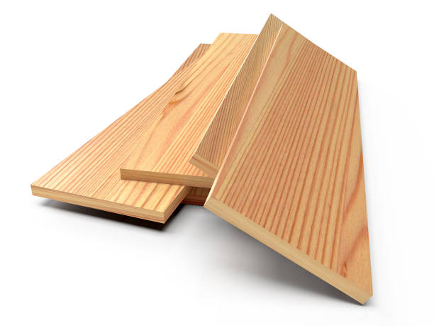
BODY MATERIAL(PVC)
Strength and Durability
Ease of Working
Customization
Cost-effectiveness
Environmental Considerations
Aesthetic Appeal
Weight

Slide 9
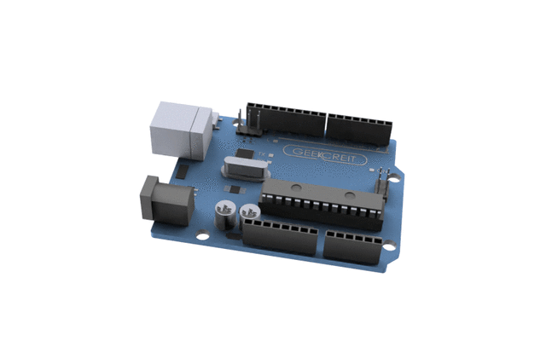
AURDINO UNO
Arduino UNO is a microcontroller board
based on the ATmega328P
It has 14 digital input/output pins
6 analog inputs
A 16 MHz ceramic resonator
A USB connection
A power jack
An ICSP header
A reset button

Slide 10
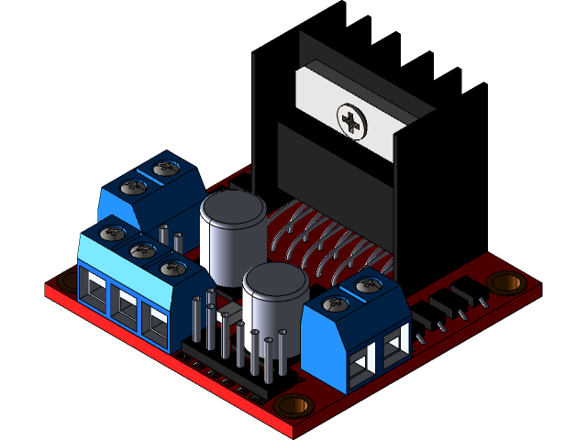
MOTOR DRIVER
We use motor drivers to give high power to the motor by using a small voltage signal from a microcontroller
If the microprocessor transmits a HIGH input to the motor driver, The driver will rotate the motor in one direction keeping the one pin as HIGH and one pin as LOW.

Slide 11
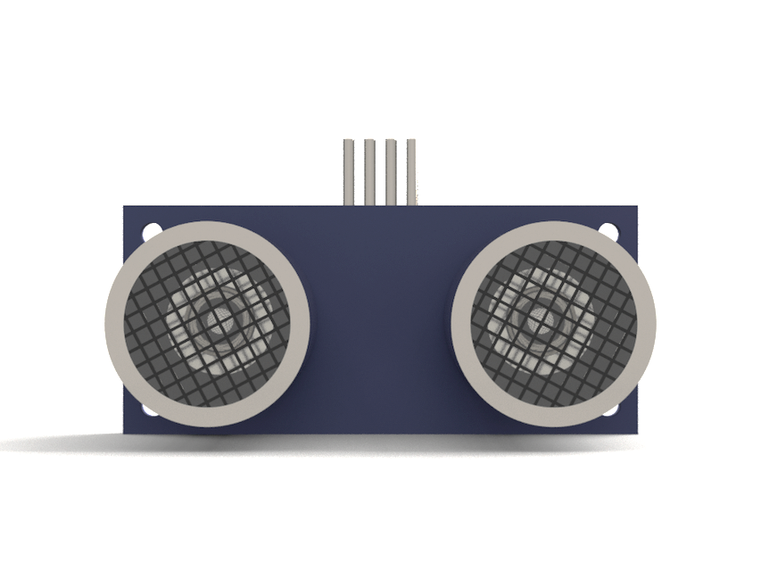
ULTRASONIC SENSORS
Ultrasonic sensors can measure the distance to a wide range of objects regardless of shape, color or surface texture.
They are also able to measure an approaching or receding object.

Slide 12
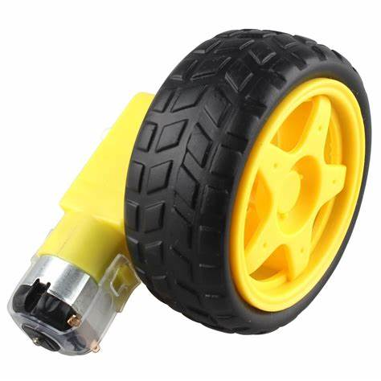
Gear Motor and Wheels
Gear motor incorporates a gear train for the purpose of reducing speed and increasing torque. It combines an electric motor with a gearbox to achieve specific speed and power output requirements. Wheels being connected to the gear motor provide the means for movement by rolling along a surface.

Slide 13
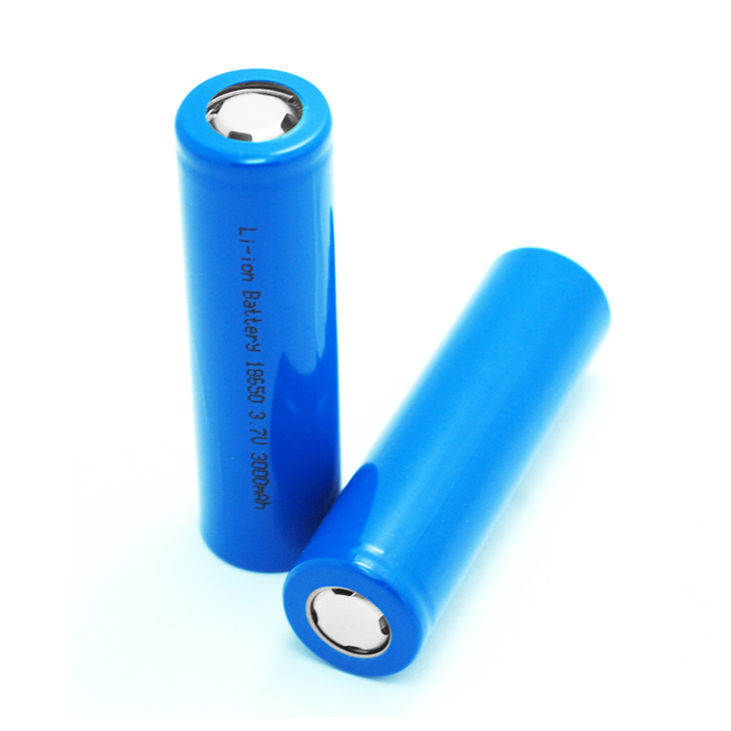
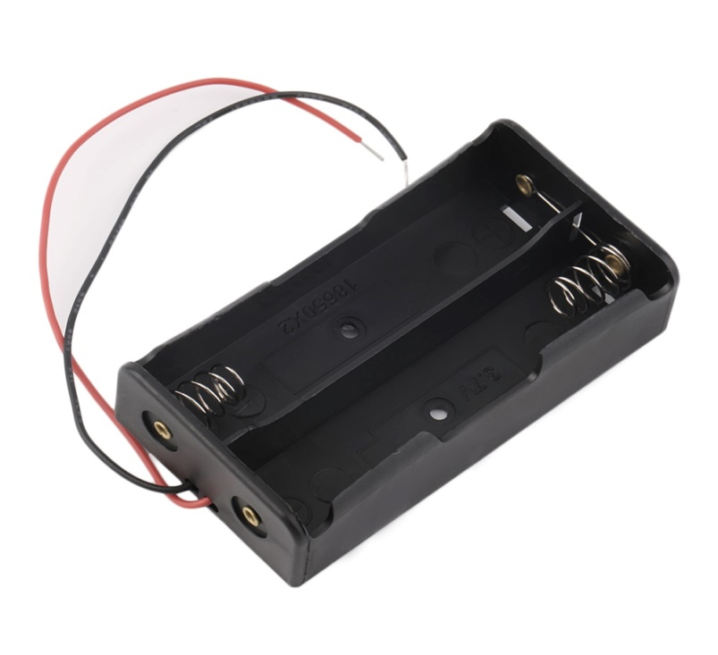
Lithium-ion Battery with Case
Lithium-ion battery uses lithium ions to store and release energy. It works by moving lithium ions between cathode and anode during charging and discharging cycles. This movement of ions creates an electric current that was used to power the device. It was favourable due to its high energy density, lightweight design, and ability to hold a charge for extended periods.

Slide 14
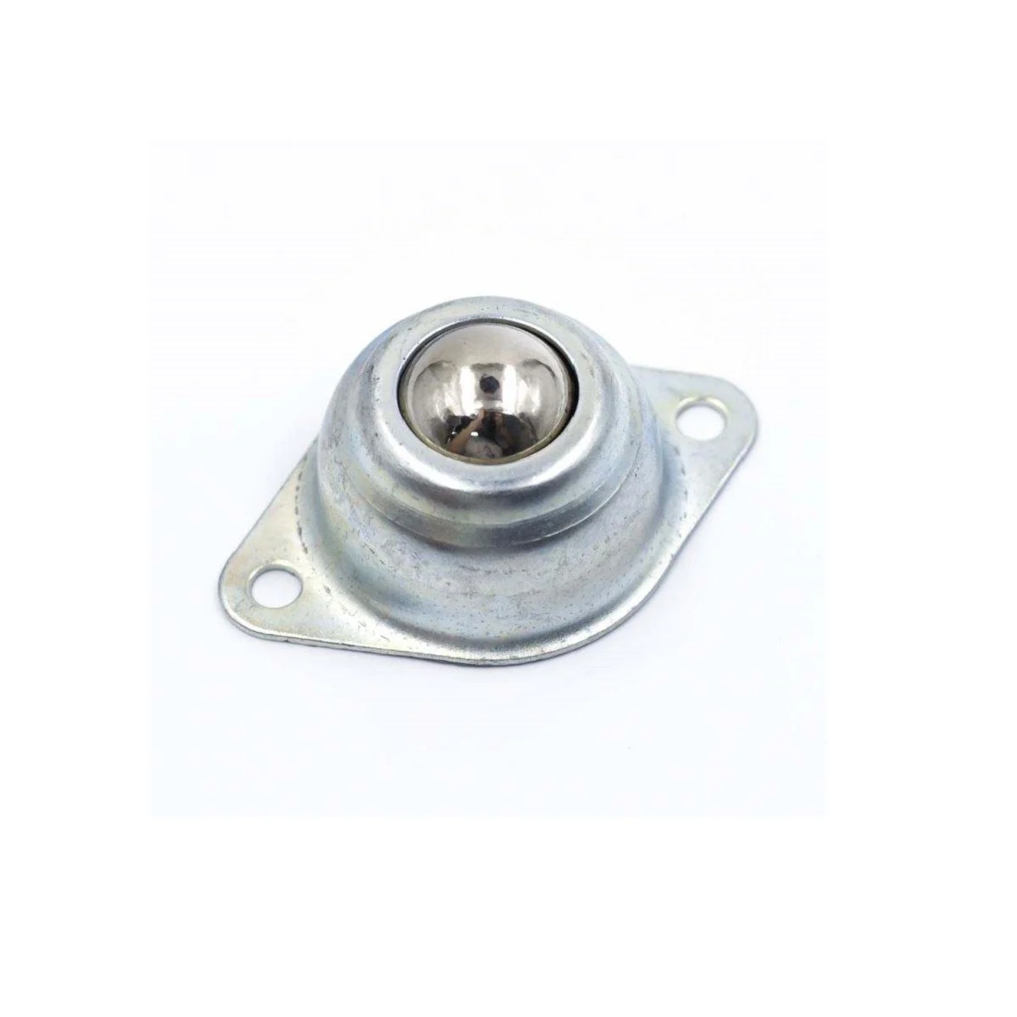
Metal Ball Caster Wheel
A metal ball caster wheel consists of a metal ball housed within a circular casing, allowing the ball to rotate freely in any direction. It enables smooth and multidirectional movement offering easy maneuverability and minimal friction.

Slide 15
WORKING
METHOD

Slide 16
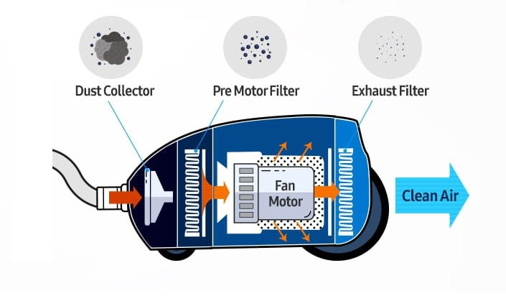
Vacuum Cleaner Filtration System

Slide 17
Device turn on
Vacuum and mopping mechanism turns on
Ultrasonic Sensor for obstacle
180° Turn
Check for impact Sensor
Yes
Left or Right
Right
Move Left
Move forward
Left
No
Move Right

Slide 18
Advantages of vaccum cleaner
Vacuum Cleaner Saves Time and Energy
Vacuum cleaner is easy to use and hygienic
Vacuum cleaner comes with advanced features
It is usually low-cost and reliable
It can Removes pet hair

Slide 19
Disadvantages of vaccum cleaner
Incapable to clean stair
Vacuum cleaner requires occasional maintenance and part replacement
Vacuum cleaner can be noisy
Difficulty with Buying Spare Parts

Slide 20
Conclusion
We completed the project very nicely. This is the first project in our life. Still we managed to complete the project beautifully.

Slide 21


